Slide 1

Saturday Special: Data Visualization
Data Science Lifecycle
(WeeK 3 : Data visualization using Python’s Seaborn Library)

Slide 2
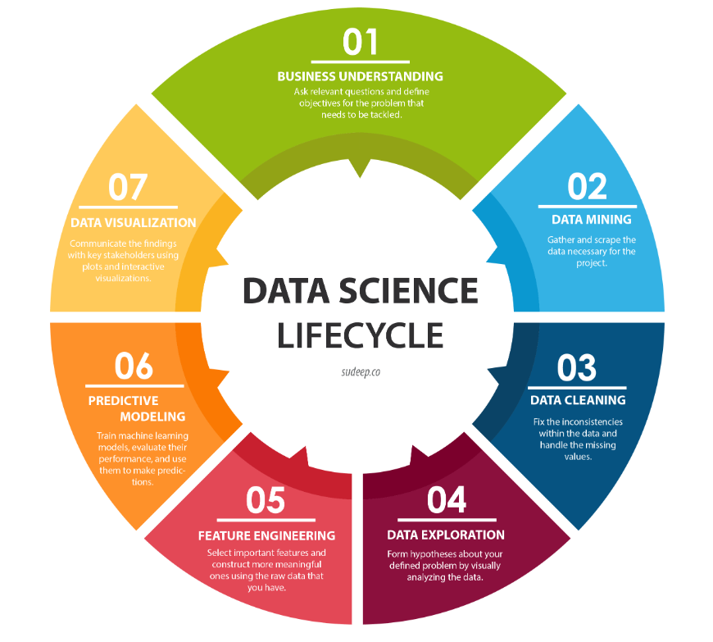
7. Data Visualization ­◉ Seventh step of the Data Science life cycle is Data Visualization

Slide 3
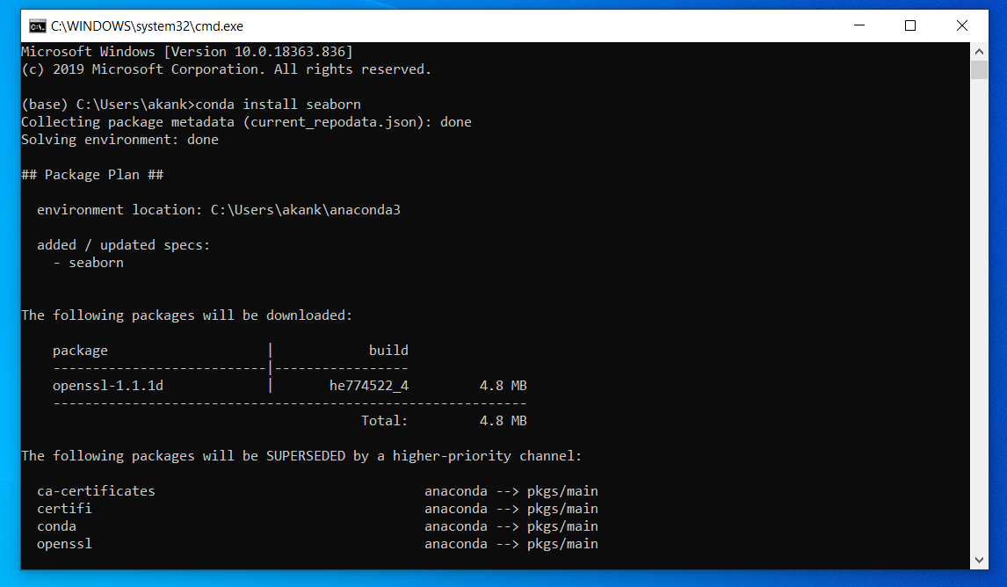
Data Visualization
Installing Seaborn
conda install seaborn
Seaborn library:
Used for Data Visualization and based on Matplotlib
It allows the creation of Statistical Graphics

Slide 4
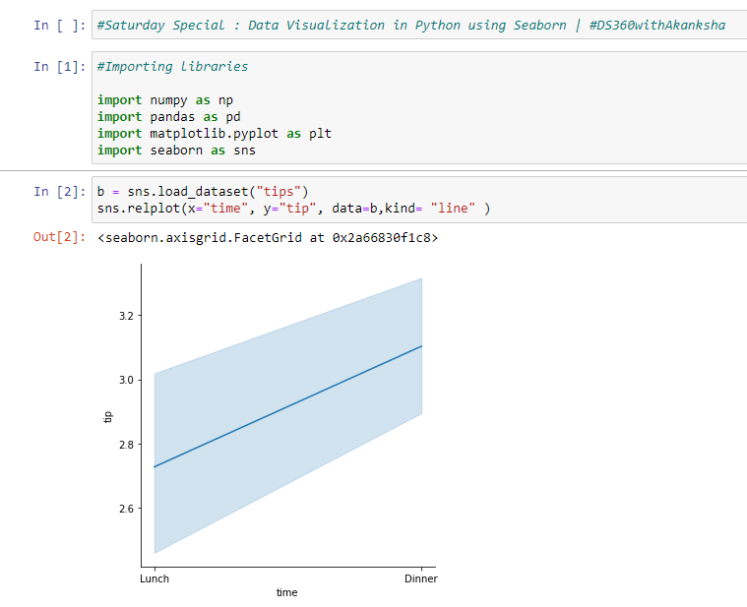
Data Visualization
Importing libraries : Numpy, Pandas, Matplotlib & Seaborn
Visualizing using lineplot

Slide 5
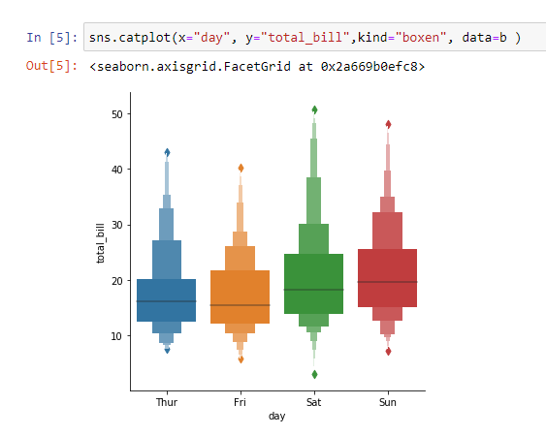
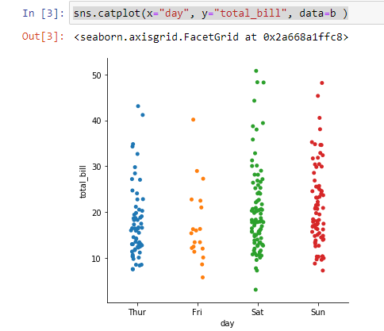
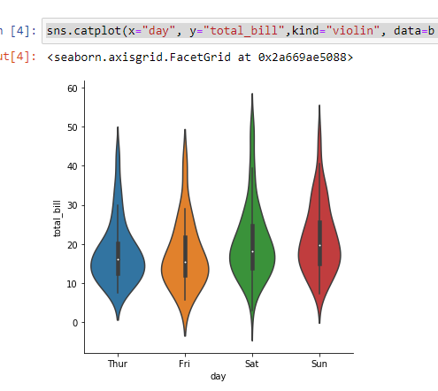
Python Seaborn Functions: Plotting with Categorical data
Different categorical plot:
Categorical scatterplots:
stripplot() (with kind="strip"; the default)
swarmplot() (with kind="swarm")
Categorical distribution plots:
boxplot() (with kind="box")
violinplot() (with kind="violin")
boxenplot() (with kind="boxen")
Categorical estimate plots:
pointplot() (with kind="point")
barplot() (with kind="bar")
countplot() (with kind="count")

Slide 6
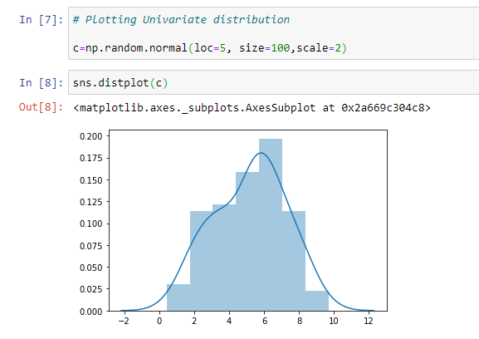
Data Visualization
Visualizing the distribution of the dataset
Plotting Univariate distribution

Slide 7
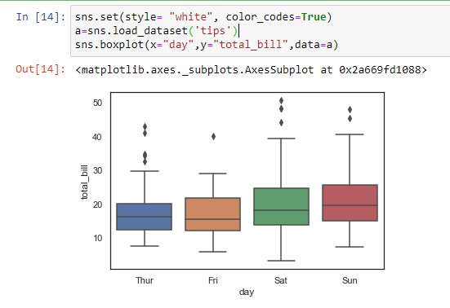
Distributions of observations within categories
Boxplot:
Shows the three quartile values of the distribution along with extreme values.
The “whiskers” extend to points that lie within 1.5 IQRs of the lower and upper quartile, and then observations that fall outside this range are displayed independently.
This means that each value in the boxplot corresponds to an actual observation in the data.

Slide 8
Next Step : 1. Business Understanding

Slide 9
References
http://sudeep.co/data-science/Understanding-the-Data-Science-Lifecycle/
Seaborn Data: https://github.com/mwaskom/seaborn-data
Seaborn Tutorial: https://www.youtube.com/watch?v=TLdXM0A7SR8&t=63s
Plotting with categorical data: https://seaborn.pydata.org/tutorial/categorical.html

